Slide 1

DOMAIN NAME AND HOSTING

Slide 2
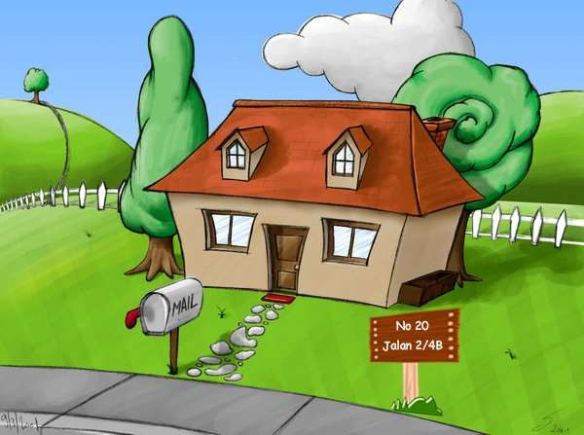
Website
Hosting
Domain

Slide 3



Slide 4
DOMAIN NAME
http://www.google.com
The domain name is a component of a Uniform Resource Locator (URL) used to access web sites, for example:
URL: http://www.google.com/
Protocol: http
Top-level domain name (TLD): com
Second-level domain name: google.com
Host name: www.google.com

Slide 5
TOP LEVEL DOMAIN
•COM - Commercial
•EDU - Educational
•GOV - Government
•INT - International
•MIL - Military
•NET - Network
•ORG - Non-Profit Organization

Slide 6
TOP LEVEL DOMAIN (COUNTRY CODE)
MY – Malaysia
ID – Indonesia
IN- India
TH – Thailand
BN - Brunei Darussalam
CN – China
AU – Australia
UK – United Kingdom

Slide 7
ICANN-ERA GENERIC TOP-LEVEL DOMAINS
.biz - business
.mobi - mobile devices
.name - individuals, by name
.info - information
.finance - financial
.fish - fishing businesses, sports, and interests
.fitness - Fitness and exercise
.training - training and how-tos

Slide 8

HOSTING

Slide 9






WHAT TO CONSIDER WHILE PICKING A DOMAIN NAME?
Keywords
Branding
Length, Hyphens, and More
Domain Extension

Slide 10
DOMAIN TOOLS
Whois
http://www.whos.com
Domain name generator
http://www.domainsbot.com/
Reverse IP Lookup
http://www.yougetsignal.com/tools/web-sites-on-web-server/

